Slide 1
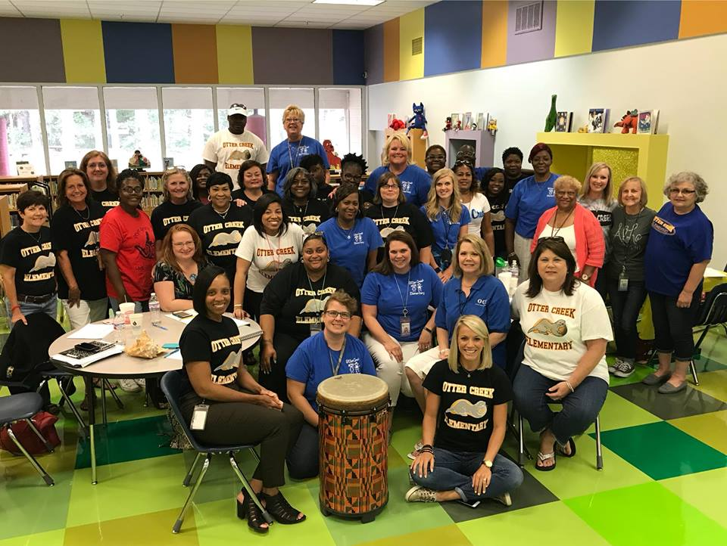
Otter Creek Elementary School
Creating a School Culture of Excellence
Wendy Minor, Principal

Slide 2
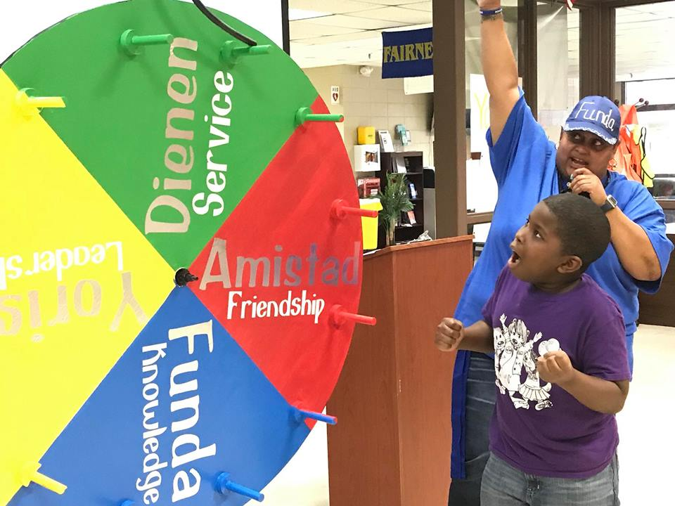
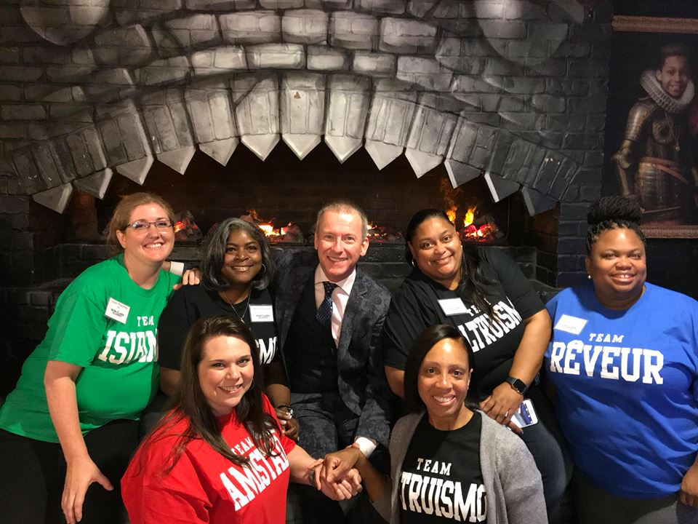
Otter Creek Elementary Celebrations
Culture and Climate
Otter Creek House System
100% Staff Participation
Monthly House Meetings
Incentive Field Trips
Team Building Activities
Daily Class Meetings
Essential 55 by Ron Clark
Daily Character & Anti-Bullying Pledges

Slide 3
Otter Creek Elementary Celebrations
High Expectations
Common Planning Time for Teachers in Master Schedule
All Teams Have Weekly PLC Meetings
Common Instructional Times for All Tiers of RTI
School-Wide Reading Action Plan
School-Wide Intervention Time Utilizing All Certified Staff

Slide 4
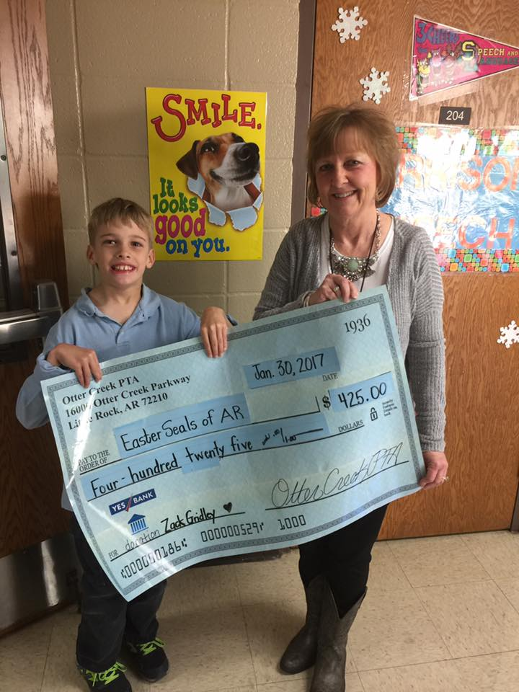
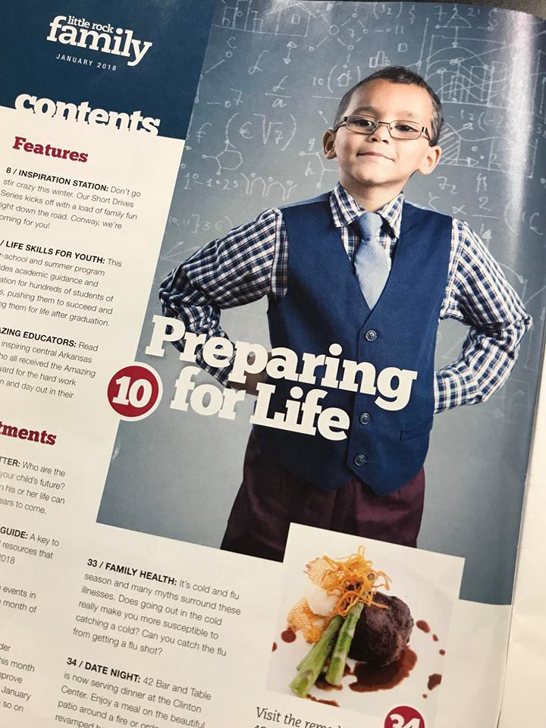
Otter Creek Elementary Celebrations
Student Support Services
Wrap Around Services
Donated Uniforms & School Supplies
Tutoring/Mentoring
School Based Mental Health
Encourager Program
AR Kids Read
Backpack Feeding Program
After School Tutoring
Partners in Education
PTA

Slide 5
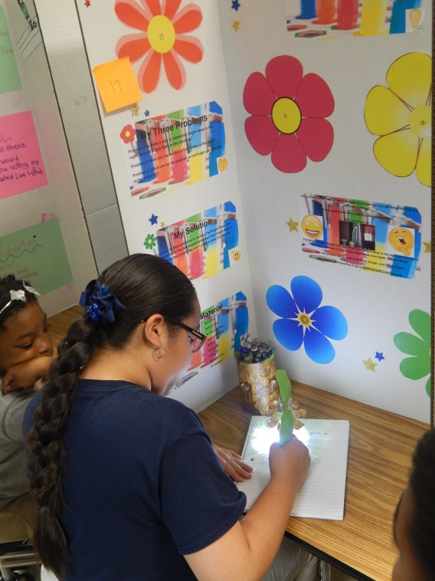
Otter Creek Elementary Celebrations
Academic Programs & Supports
Reading Teacher
Title I Academic Intervention Specialist
1:1 Laptops for Grades 4 & 5
4th & 5th Grade Science Fair
Gifted and Talented Pullout Program 3-5
Chrome Books for All 3rd Grade Students
RTI Tiered Support by Certified Staff
Lexia Reading Core5 School-Wide
Accelerated Reader

Slide 6
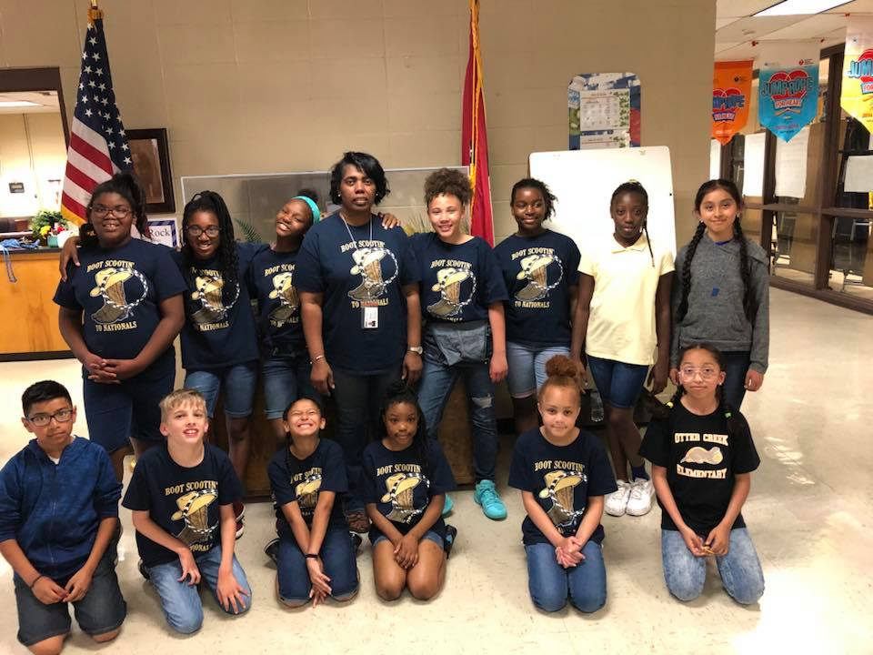
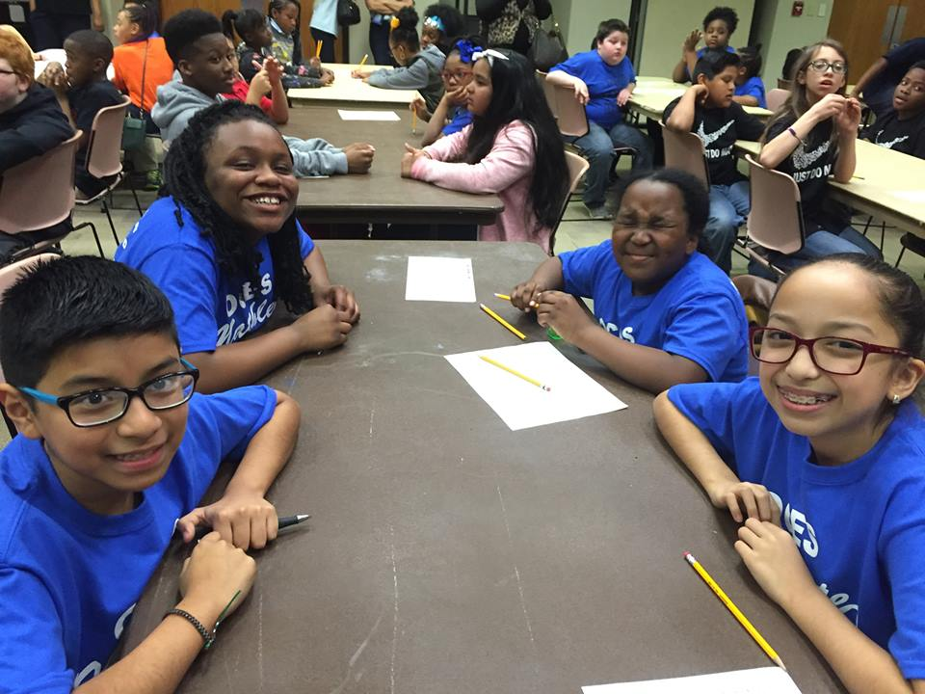
Otter Creek Elementary Celebrations
Enrichment
Natural Steppers Jump Rope Team
You Otter Know News Team
Quiz Bowl Team
Poetry Club
Mathletes
Otter Creek Science Fair 4-5th Grade
District Science Fair Participation
Regional Science Fair Participation
Student Council Representatives

Slide 7
Otter Creek NWEA Map Growth K-2 Assessment 2018 Growth Results
Percentage of Students Meeting RIT Growth Projections by Spring
 | Reading | Math
Kindergarten | 38% | 31%
First Grade | 43% | 45%
Second Grade | 26% | 27%

Slide 8
Otter Creek ACT Aspire Summative Assessment
Otter Creek Overall School Performance
Percentage of Students Performing at Ready or Exceeding
 | 2016 | 2017 | 2018
Reading | 29% | 27% | 26%
Math | 39% | 43% | 38%

Slide 9
Otter Creek ACT Aspire Summative Assessment
Otter Creek 3rd Grade
Percentage of Students Performing at Ready or Exceeding
 | 2016 | 2017 | 2018
Reading | 28% | 25% | 24%
Math | 48% | 46% | 49%

Slide 10
Otter Creek ACT Aspire Summative Assessment
Otter Creek 4th Grad e
Percentage of Students Performing at Ready or Exceeding
 | 2016 | 2017 | 2018
Reading | 31% | 29% | 34%
Math | 37% | 48% | 38%

Slide 11
Otter Creek ACT Aspire Summative Assessment
Otter Creek 5th Grade
Percentage of Students Performing at Ready or Exceeding
 | 2016 | 2017 | 2018
Reading | 26% | 26% | 22%
Math | 29% | 35% | 32%

Slide 12
Otter Creek School Improvement Plan
Goal 1: (Leadership) To facilitate authentic Professional Learning Communities (PLCs) for 85% of the weeks of school, for at least 60 minutes each meeting, and at a 95% attendance rate of members.
Goal 2: (Student Achievement) To increase student achievement in reading and math by 10% at each grade level.
Goal 3: (Culture, Discipline, Parent Involvement) To track & reduce student office referrals throughout 2018-2019.

